Slide 1
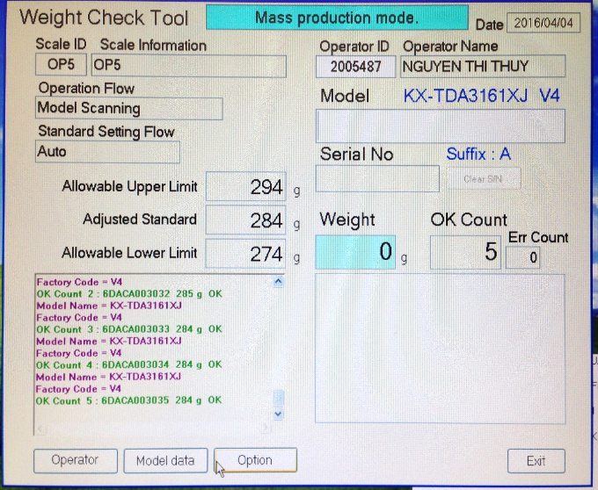
PBX-MODIFY WEIGHT
CHECK SOFTWARE
BEFORE
No | Operation | Remark
1 | Scan Model name on Carton box
2 | Scan Serial No. on Carton box
After
No | Operation | Remark
1 | Scan Serial No. of Charger | Select field – Line leader input to “ Model data ” item have barcode or not
2 | Scan Serial No. of Product
3 | Scan barcode of Inner box | Select field – Line leader input Part No. to “ Model data ”
4 | Scan Model name on Carton box
5 | Scan Serial No. on Carton box
6 | Scan barcode of Outer box | Select field – Line leader input Part No. to “ Model data ”
7 | Scan barcord of SET label 1
8 | Scan barcord of SET label 2
9 | Scan barcord of Caution label
Compare Serial No. between : Charger , product and Carton box → Prevent Serial No. different
Compare part No. of Carton box , Set label → Prevent wrong part Carton box , Set label

Slide 2
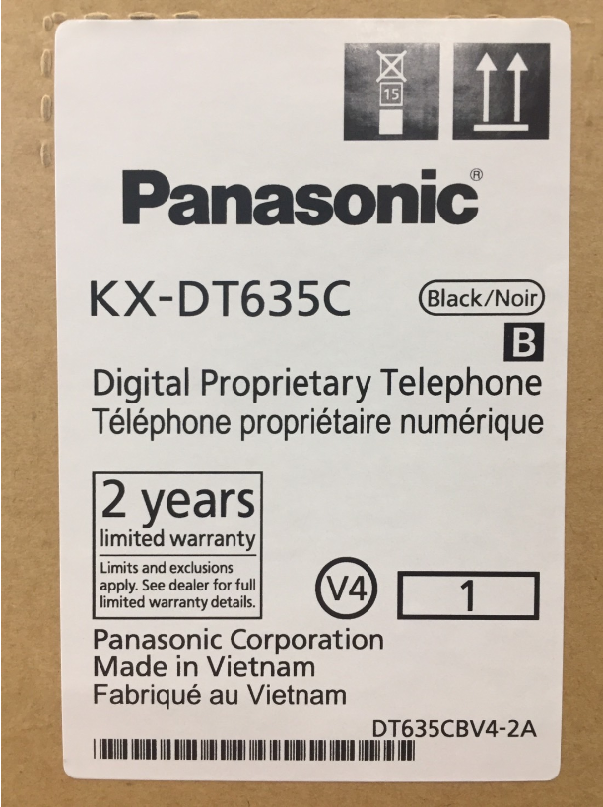
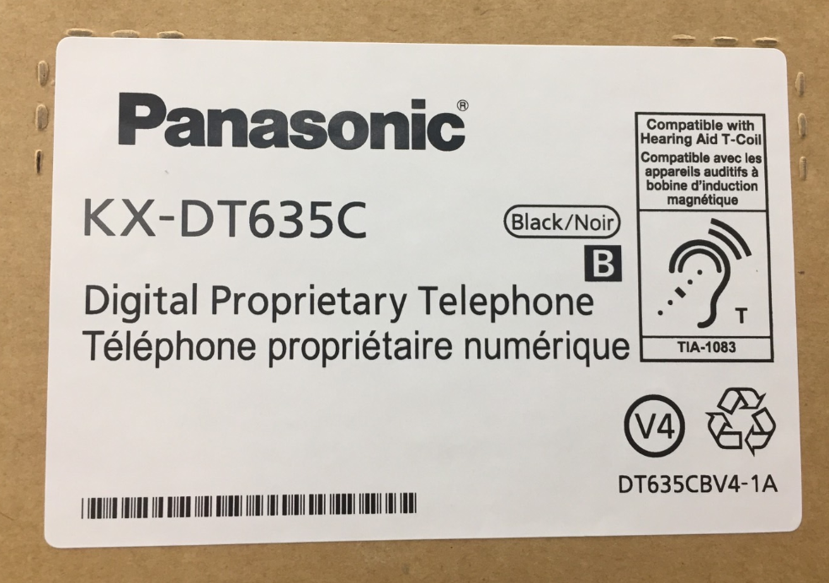
Barcode of Set label
Barcode indication part No. of label

Slide 3
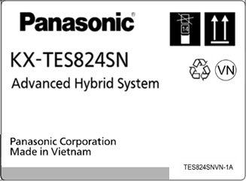
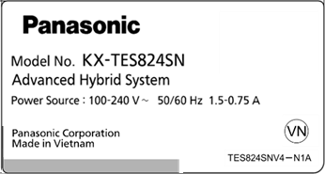
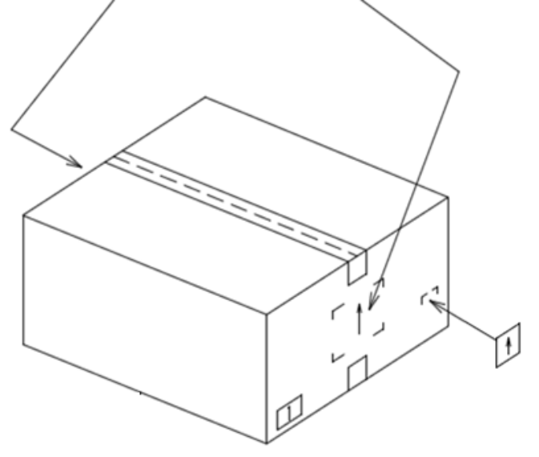
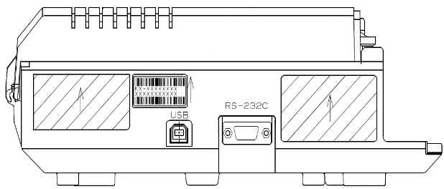

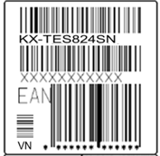
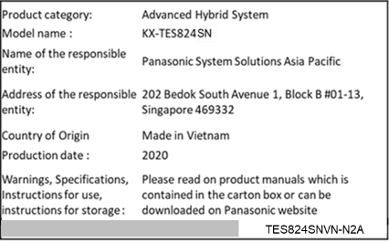
Request for Correspondence contents
Example, KX-TES824SN
・Product
・Packing
Add a barcode and
clearance area
Add Consumer Protection Law Label (In-house)

